Slide 1
Finding Eulerian Circuits of equal weights in a given weighted Graph
Assignment 2- Topics in Graph Theory

Slide 2
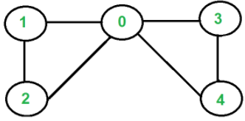
Introduction
Given a Graph G =(V, E), the problem is to find equal weighted eulerian circuits in a given Weighted Graph.
Eulerian Circuit is a circuit which traverses each edge exactly once and ends at the same vertex where it started.
A weighted Graph is a graph where weights are given for the edges.
In Fig1. The Graph has Eulerian Circuits “2-1 1-0 0-2”, “0-3 3-4 4-0” and “0-1 1-2 2-0 0-4 4-3 3-0”
Fig.1

Slide 3
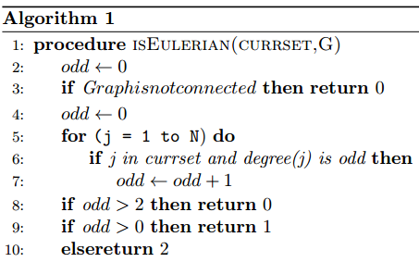
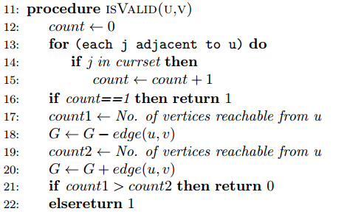
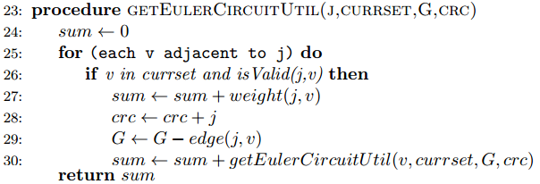
Approach 1: Time Complexity O((N+M)²*(2^{N}))

Slide 4
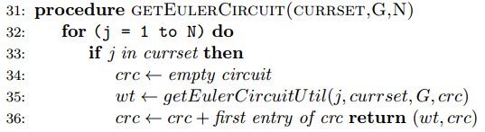
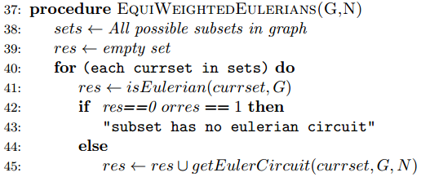
Approach 1: Time Complexity O((N+M)²*(2^{N}))

Slide 5
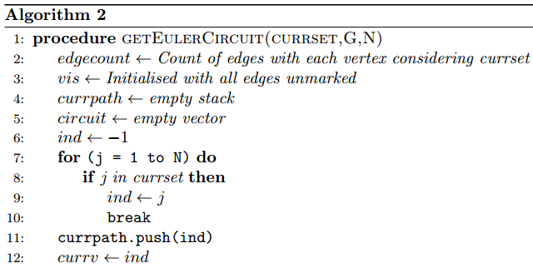
Approach 2: Time Complexity O((N+M)(2^{N}))

Slide 6
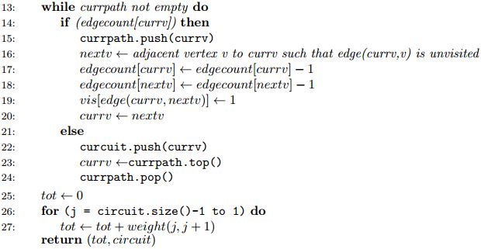
Approach 2: Time Complexity O((N+M)(2^{N}))

Slide 7
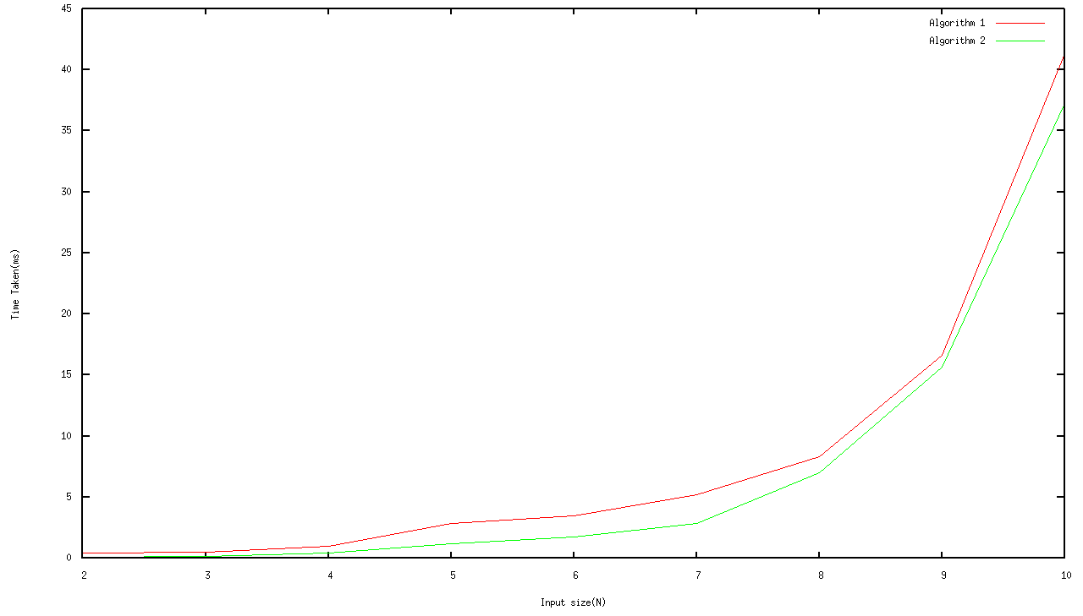
Input Size Vs Time Graph

Slide 8
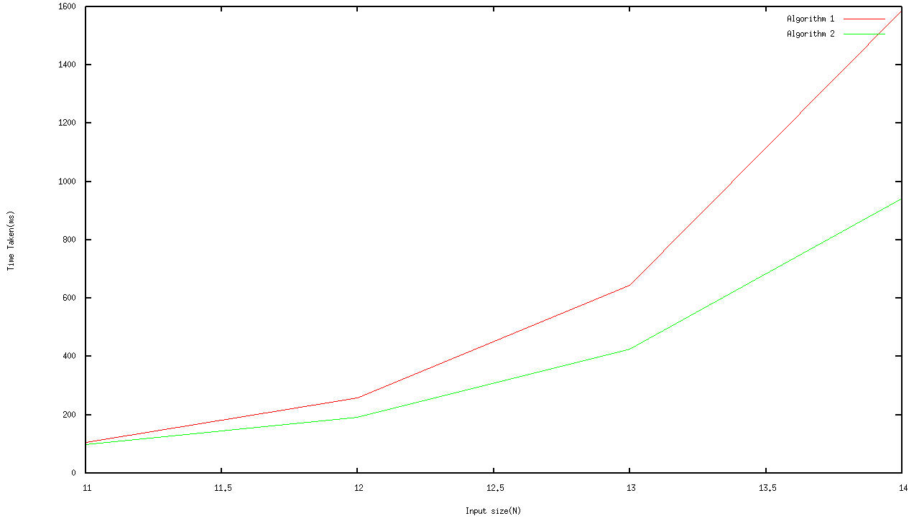
Input Size Vs Time Graph

Slide 9
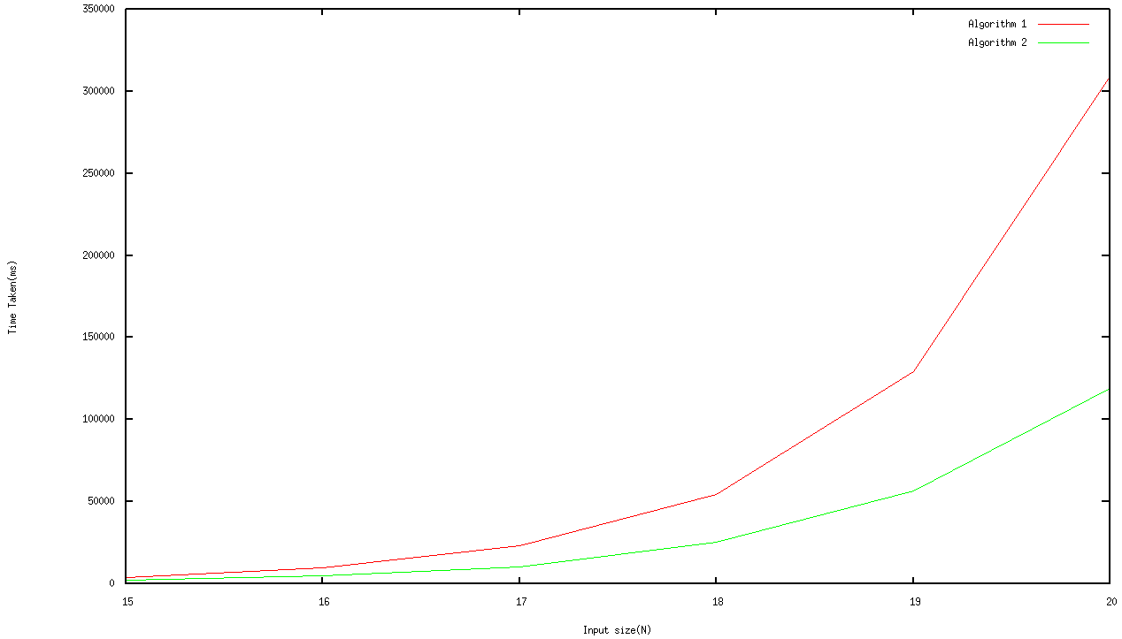
Input Size Vs Time Graph

Slide 10
Conclusion
Given Weighted Graph can be represented in the form of Adjacency List.
Equal weighted Eulerian Circuits can be found by traversing this Adjacency List.
The two Algorithms have been proposed:
Method 1: Time Complexity O((N+M)²*(2^{N}))
Method 2: Time Complexity O((N+M)*(2^{N}))

